Slide 1
INSTRUCTIONS FOR CREATING A LANDSCAPE POSTER FOR THE ENGINE 2022 SHOWCASE
QUESTIONS? EMAIL: PR_TEAM@ECE.UW.EDU
1. VIEW THE EXAMPLE (2) AND BLANK LANDSCAPE TEMPLATE (3) BELOW.
NAVIGATE TO THEM USING SLIDES ON THE LEFT.
2. WE’VE COPIED THE BLANK TEMPLATE (3) TO A NEW SLIDE (4) FOR YOU TO
BEGIN CREATING YOUR POSTER.
IF YOU’D LIKE TO CREATE DIFFERENT VERSIONS OF YOUR POSTER, RIGHT CLICK & CHOOSE “DUPLICATE SLIDE”.
3. TO DISPLAY GUIDES, PRESS CMD + OPTION + CONTROL+ G (MAC) / ALT + F9 (WIN)
OR GO TO VIEW – GUIDES IN THE POWERPOINT MENU.
4. WHEN FINISHED, SAVE IN THE FORMAT REQUIRED BY YOUR PRINTING VENDOR
5. IMPORTANT!! DO NOT CHOOSE TO ‘OPEN WITH GOOGLE SLIDES’!
YOUR TEMPLATE WILL NOT BE FORMATTED PROPERLY. DOWNLOAD AND OPEN WITH POWERPOINT.
*PREFERRED FONTS ARE USED IN THIS SAMPLE PRESENTATION: ENCODE SANS FOR TITLES AND OPEN SANS FOR BODY. UNI SANS IS ALSO ALLOWED –
These can be downloaded and installed on your computer for free here: https://www.washington.edu/brand/graphic-elements/font-download/

Slide 2
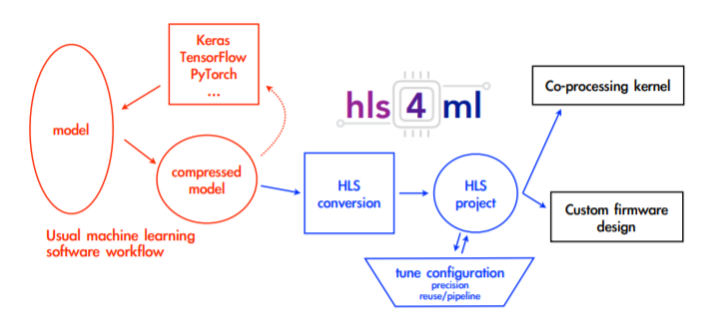
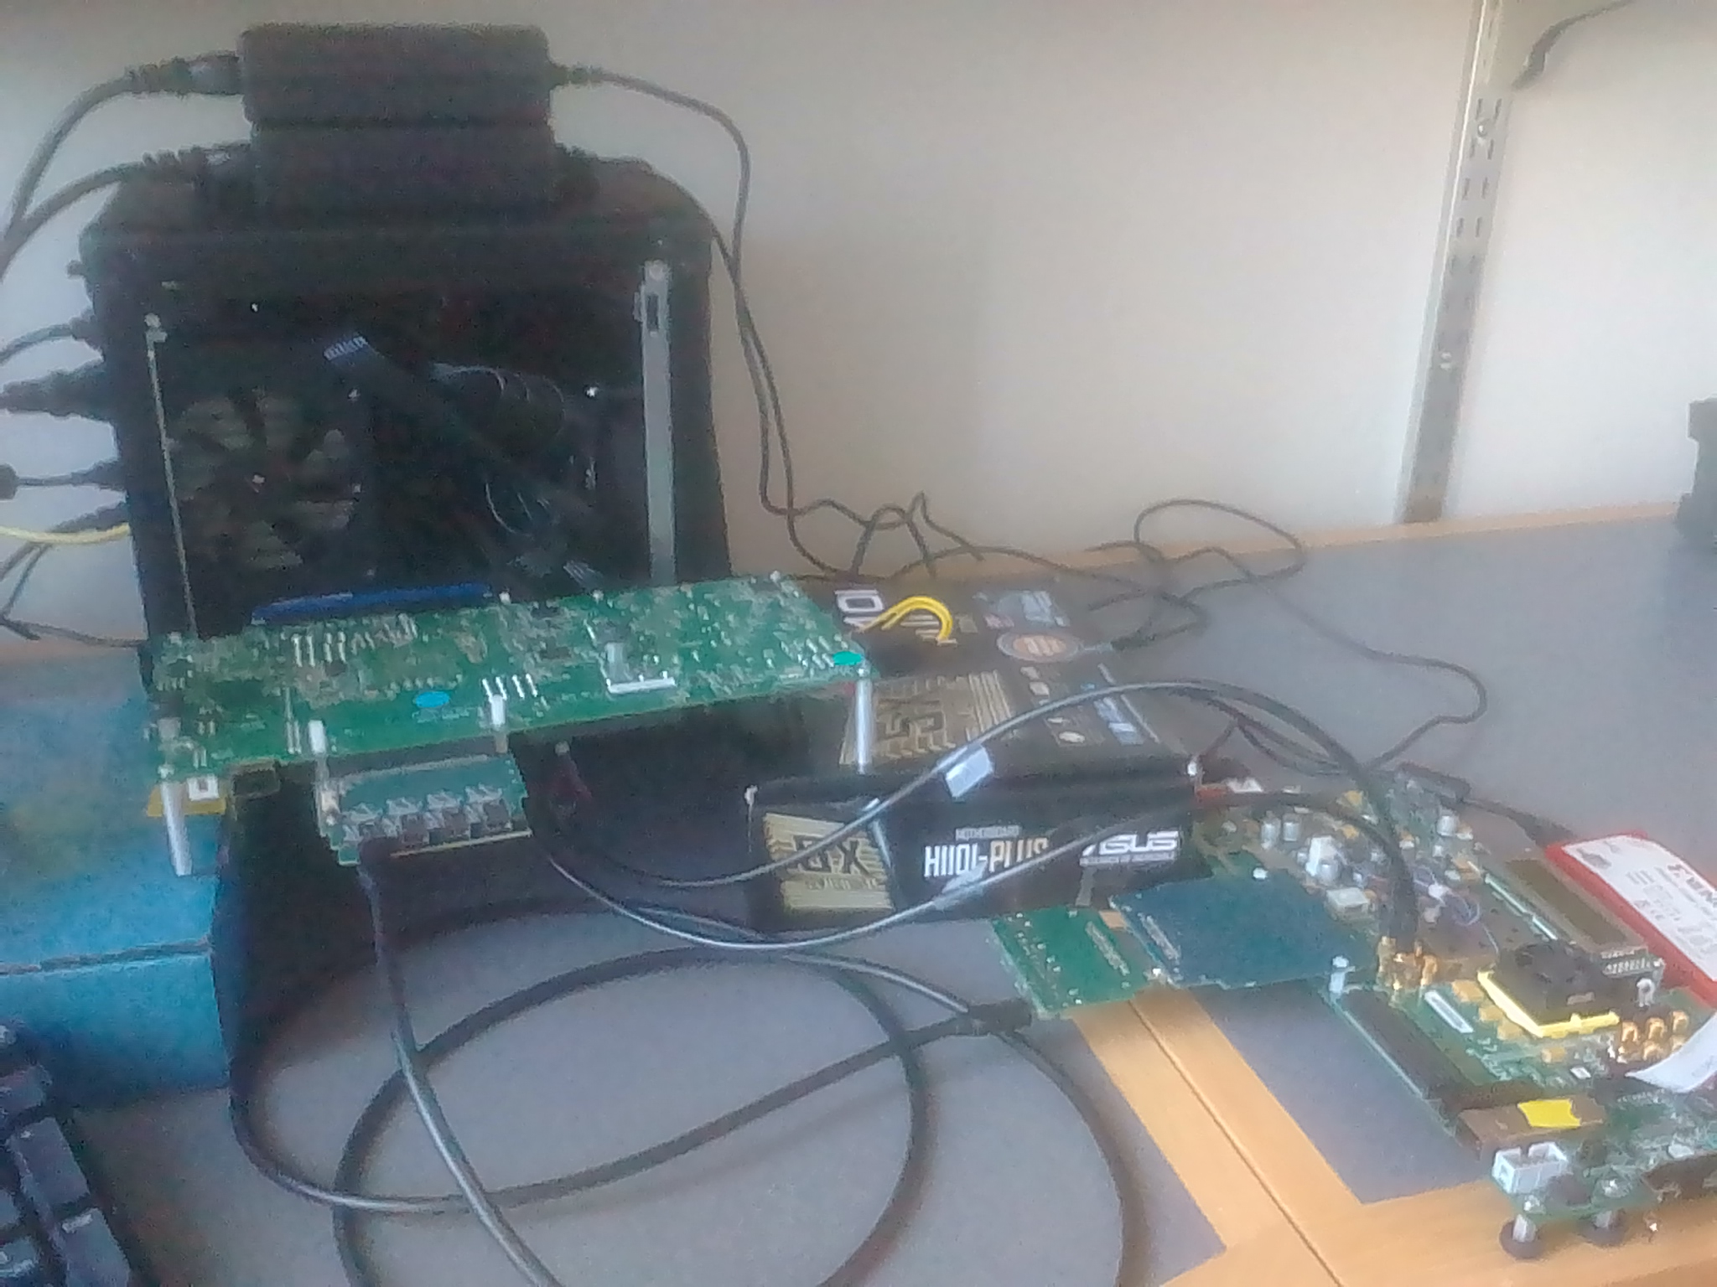
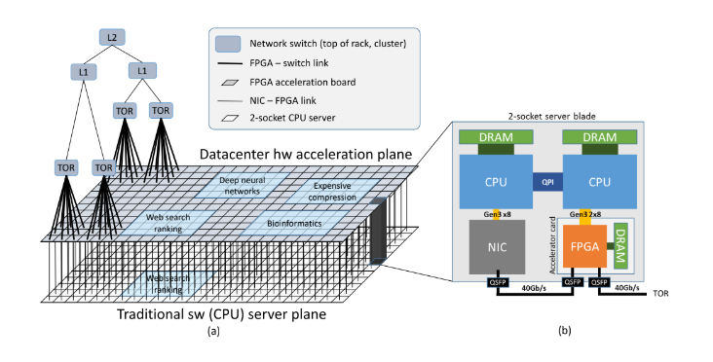
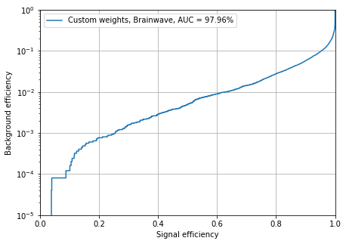
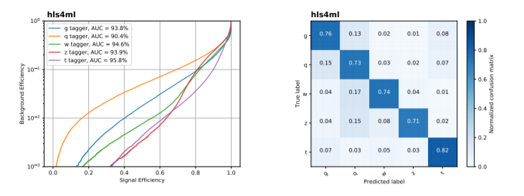
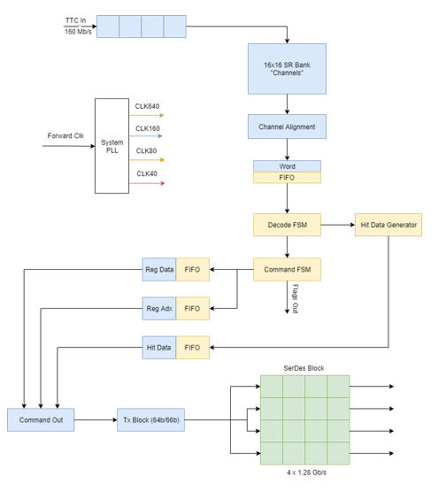
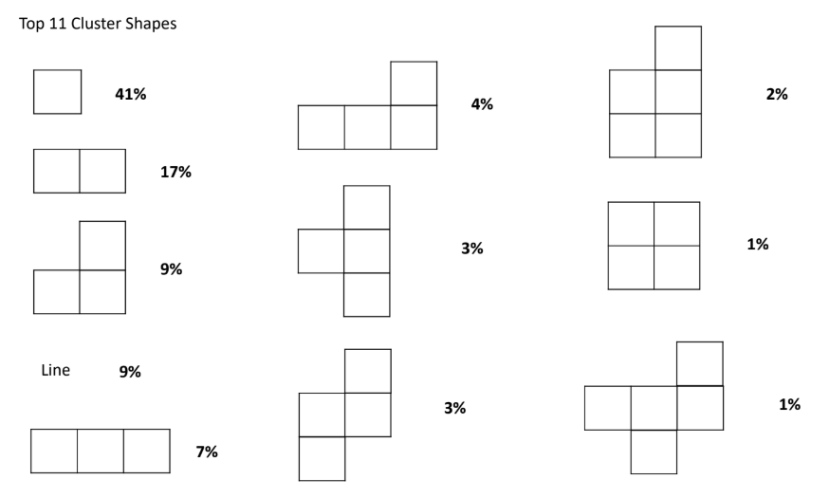
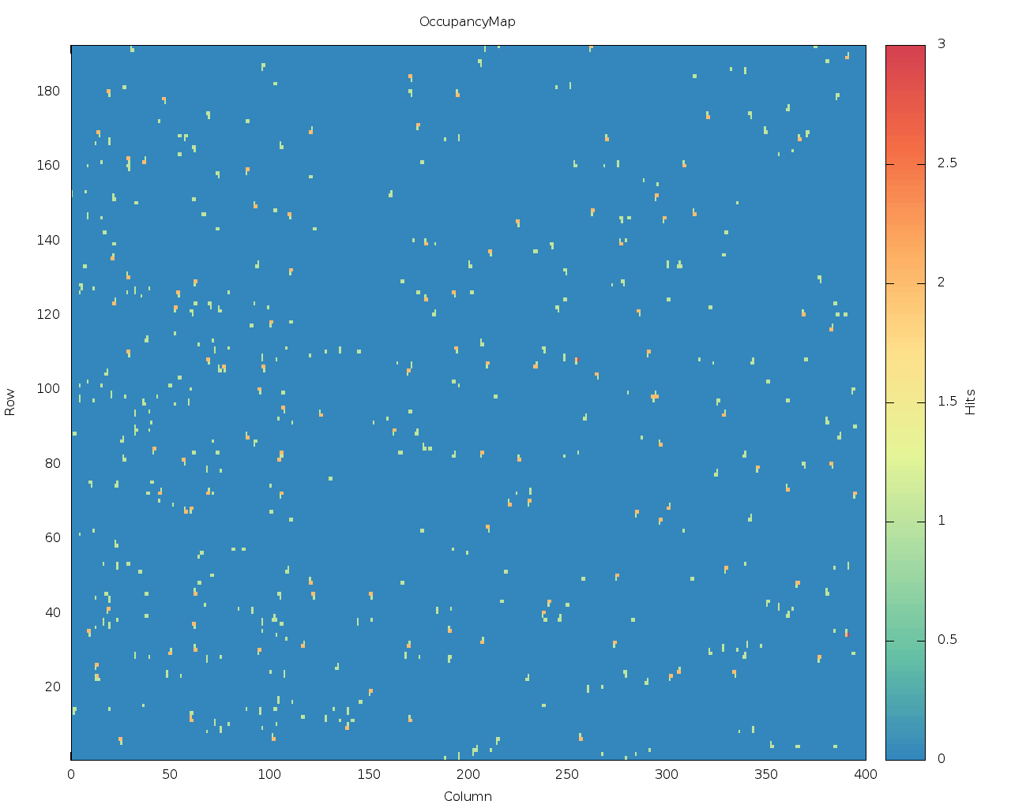
Machine Learning for Smart Space Based Radiation Sensors
STUDENTS: Tony Tarng, Frank Gu
The Large Hardon Collider
Machine Learning Acceleration for HEP
Hls4ml
The Large Hadron Collider (LHC) is the largest particle collider in the world. Physicists are interested in observing rare events by colliding two high energy particle beams.
An upcoming upgrade to the detector will substantially increase the amount of collisions per second.
New technologies are being developed to cope with the substantial increase in particle flux.
Machine Learning is a popular solution to HEP issues, like hit tagging.
However, ML needs hardware acceleration to be effective at large scale.
ACME Lab is working with CMS at Fermilab to make machine learning acceleration accessible to the HEP community.
FPGAs are a leading candidate for ML acceleration going forward. However, they require specialized knowledge to use.
hls4ml is a tool that takes standard Neural Framework representations of DNNs and compiles them for use on FPGAs without requiring deep knowledge of FPGAs.
ML Acceleration in the Cloud
RD53A Emulator
Microsoft provides a cloud service called Brainwave, which applies FPGAs to the task of machine learning acceleration.
We are doing research into the efficacy of Brainwave for HEP applications.
Results look promising in the area of Top quark tagging.
ACME Lab is developing an FPGA emulator of the LHC RD53A chip.
The Emulator is able to recreate accurate hit signatures without actually being exposed to radiation, greatly simplifying its use.
The emulator can be used for stress testing and can easily be reconfigured to target specific test cases.
[2]
Emulator Features
[1]
Hit Data/ Hit Generator
Input data is received at 160 MBPS and is decoded using the custom RD53A protocol.
The received data is split into system commands and triggers (requests for hit data) and each is sent to their respective response units.
Commands are decoded and processed into appropriate system behavior such as rd-reg or wr-reg.
Triggers are processed and produce hit data.
Command and trigger output are combined into one data stream.
This data is split over four lanes and is encoded using Aurora 64/66B at 640 Mbps.
One of our main goals in the RD53A project is to produce realistic data that matches what would be seen in the LHC.
To determine what our data should look like we have been usingmage processing techniques to analyze real data from the LHC.
Our testing has shown that most of the data consists of simple shapes and lines.
Data is pseudo-randomly generated and output from the system via the Aurora lanes described to the right.
A sample image to the right shows a generated hit patterning.
To determine what our data should look like we have been using image processing techniques to analyze real data from the LHC.
[2]
Current neural architectures under development:
Fully Connected
Convolutional NN
Current Framework support under development:
TensorFlow
Keras
Future Work, References, and Acknowledgments
Further improvements to hls4ml
Scaling up of Brainwave
Finish implementing the RD53A hit data generator
Start planning the upgrade to RD53B, the next test chip
Faculty: Scott Hauck, Shih-Chieh Hsu
Graduate Students: Douglas Smith, Dustin Werran, Richa Rao
Undergraduate Students: Tony Faubert, Jessica Lan, Kylie Lim, Matthew Trahms, Donovan Erickson
[1] A. Caulfield, E. Chung, A. Putnam, H. Angepat, J. Fowers, M. Haselman et al., A cloud-scale acceleration architecture, IEEE Computer Society, October, 2016.
[2] J. Duarte et. al., Fast inference of deep neural networks in FPGAs for particle physics, arXiv:1804.06913v3 [physics.ins-det] 28
ADVISORS: JOHN DOE, ROBERT WALTER, WILLIAM RICHARDS, JANE DOE
SPONSORS: ELECTRICAL & COMPUTER ENGINEERING DEPARTMENT, UNIVERSITY OF WASHINGTON

Slide 3
Robot Localization
STUDENTS: Tony Tarng, Frank Gu
ADVISORS: JOHN DOE, ROBERT WALTER, WILLIAM RICHARDS, JANE DOE
SPONSORS: ELECTRICAL & COMPUTER ENGINEERING DEPARTMENT, UNIVERSITY OF WASHINGTON

Slide 5
YOUR TITLE GOES HERE. IT MUST BE LEFT ALIGNED.
(MIN: 60 PX, MAX 90PX)
Robot Localization
STUDENTS: FIRST & LAST NAME, FIRST & LAST NAME, FIRST & LAST NAME
Version:0.9 StartHTML:0000000105 EndHTML:0000001393 StartFragment:0000000141 EndFragment:0000001353
In this project, you will select a topic related to (1) localization, (2) planning and/or (3) control for 2D navigation.
We will provide you with a set of occupancy maps and a laser scanner simulator for you to generate training
data and run simulations. This project is a bit more open-ended than the previous project in that you are free
to choose the topic as long as you use the dataset provided. You may borrow code from the other homework
assignments as you wish.
ADVISOR: FIRST & LAST NAME
INDUSTRY MENTOR: FIRST & LAST NAME
SPONSOR: SPONSOR TITLE
Notes:
Horizontal Version

Slide 6
YOUR TITLE GOES HERE. IT MUST BE LEFT ALIGNED.
(MIN: 60 PX, MAX 90PX)
STUDENTS: FIRST & LAST NAME, FIRST & LAST NAME, FIRST & LAST NAME
ADVISOR: FIRST & LAST NAME
INDUSTRY MENTOR: FIRST & LAST NAME
SPONSOR: SPONSOR TITLE
Notes:
Horizontal Version

